Slide 1
Agenda
Structural Design Patterns
Structural Patterns
Adapter
Bridge
Composite
Decorator
Façade
Proxy
Flyweight

Slide 2
Structural Design Patterns (7 Design Patterns)
Deals with the composition of objects structures.
The concept of inheritance is used to compose interfaces and define various ways to compose objects for obtaining new functionalities.
Adapter
Bridge
Composite
Decorator
Façade
Flyweight
Proxy

Slide 3
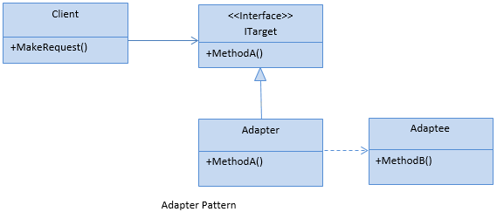
Adapter Pattern
Acts as a bridge between two incompatible interfaces.
Involves a single class called adapter which is responsible for communication between two independent or incompatible interfaces.

Slide 4

Adapter Pattern Real Life Example

Slide 5
Types of Adapter Pattern
Adapter
Class Adapter
Object Adapter

Slide 6
Adapter Pattern Examples
Data Transfer Object (DTO) to Business Object
Need to convert third party objects to application types
ADO.NET SqlAdapter, OracleAdapter, MySqlAdapter

Slide 7
DEMO
Adapter Pattern Example

Slide 8
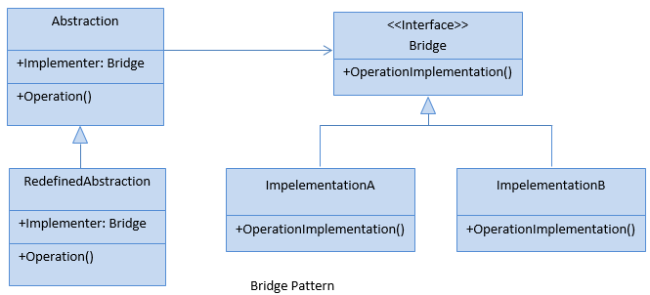
Bridge Pattern
Bridge pattern is used to separate abstraction from its implementation so that both can be modified independently.
This pattern involves an interface which acts as a bridge between the abstraction class and implementer classes and also makes the functionality of the implementer independent from the abstraction.
Notes:
All we know, Inheritance is a way to specify different implementations of an abstraction. But in this way, implementations are tightly bound to the abstraction, cannot be modified independently. The Bridge pattern provides an alternative to inheritance when there is more than one version of an abstraction.

Slide 9
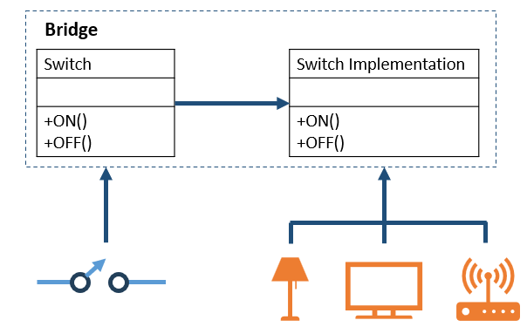
Bridge Pattern Real Life Example

Slide 10
Bridge Pattern Examples
Payment Features:
Currently Credit Card, Debit Card
In Future add more
Cross-Platform GUI: ReactNative
GUI Component
Platform Specific Implementation
In Future add more
Messaging Features:
Currently SMS or Email
In Future add more
Notes:
Bridge pattern has nearly the same structure as the Adapter Pattern. But it is used when designing new systems instead of the Adapter pattern which is used with already existing systems.

Slide 11
Bridge Pattern Real Life Example
Abstractions and implementations should be modified independently.
Changes in the implementation of an abstraction should have no impact on clients.
Used when a new version of a software or system is brought out, but the older version of the software still running for its existing client. There is no need to change the client code, but the client need to choose which version he wants to use.
Notes:
In a software product development company, the development team and the marketing team both play crucial roles. The marketing team does a market survey and gathers the customer requirements. The development team implements those requirements in the product to fulfill the customer needs. Any change (say, in the operational strategy) in one team should not have a direct impact on the other team. In this case, you can think of the marketing team as playing the role of the bridge between the clients of the product and the development team of the software organization.

Slide 12
DEMO
Bridge Pattern Example

Slide 13
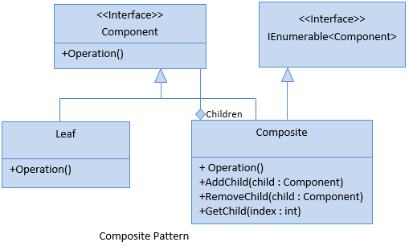
Composite Pattern
Composite pattern is used when we need to treat a group of objects and a single object in the same way.
Composite pattern composes objects in term of a tree structure to represent part as well as whole hierarchies.
Notes:
The concept is useful when you want to add some special functionality to a specific object instead of the whole class. This pattern prefers object composition over inheritance.

Slide 14
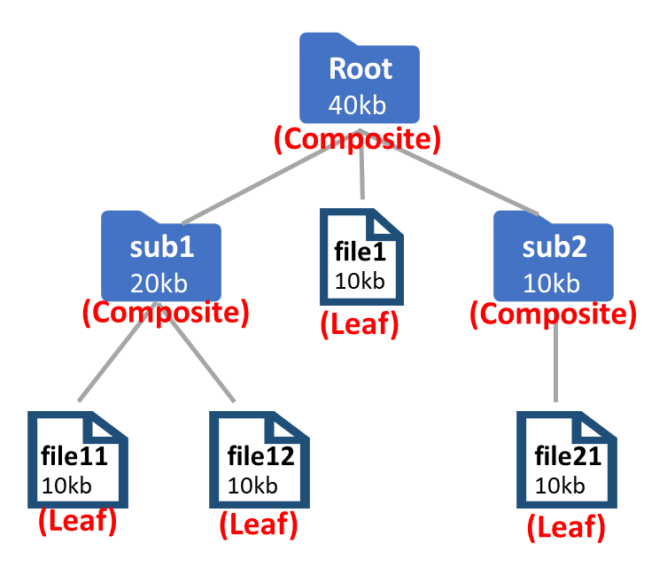
Composite Pattern Real Life Example

Slide 16
Composite Pattern Examples
File System Folders
Managers and Employees
Assemblies

Slide 17
DEMO
Composite Pattern Example

Slide 18
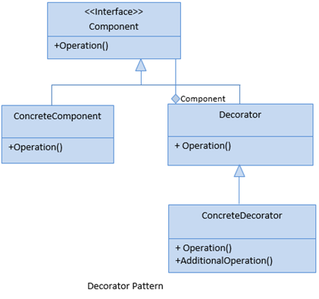
Decorator Pattern
Decorator pattern is used to add new functionality to an existing object without changing its structure.
This pattern creates a decorator class which wraps the original class and add new behaviors/operations to an object at run-time.
An another way to implement inheritance.
Notes:
The concept is useful when you want to add some special functionality to a specific object instead of the whole class. This pattern prefers object composition over inheritance.

Slide 19
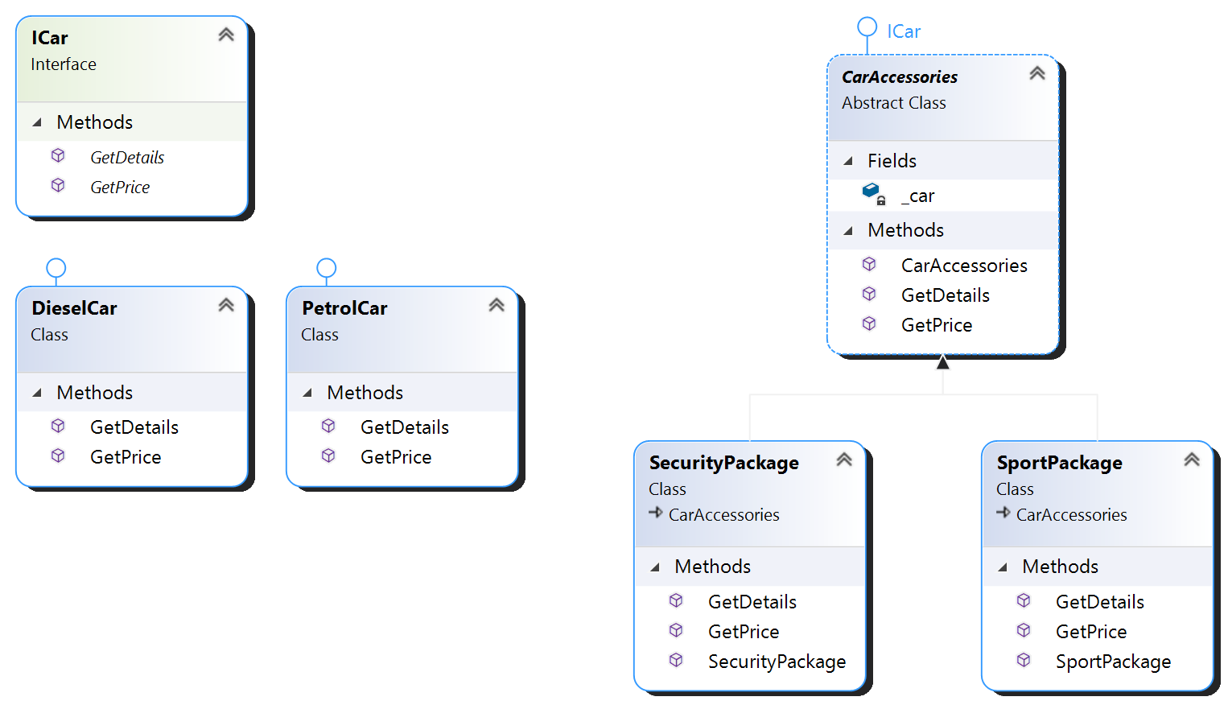
Decorator Pattern Real Life Example
Notes:
Advantage of Decorator Pattern
It provides greater flexibility than static inheritance.
It enhances the extensibility of the object, because changes are made by coding new classes.
It simplifies the coding by allowing you to develop a series of functionality from targeted classes instead of coding all of the behavior into the object.

Slide 20
Decorator Pattern Examples
Build Your Own Computer Order
RAM options
Storage Options
Processor Options
Build Your Own Car Order
Accessories Options
Security
Sports

Slide 21
DEMO
Decorator Pattern Example

Slide 22
Alternatives to Decorators
Pattern | Intent
Adapter | Converts one interface to another so that it matches what the client is expecting
Decorator | Dynamically adds responsibility to the interface by wrapping the original code
Facade | Provides a simplified interface

Slide 23
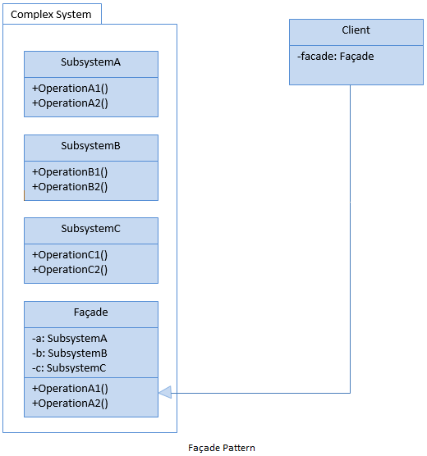
Facade Pattern
Facade pattern hides the complexities of the system and provides an interface to the client using which the client can access the system.
This pattern involves a single wrapper class which contains a set of members which are required by the client. These members access the system on behalf of the facade client and hide the implementation details.
Provides a higher-level interface that makes the subsystem easier to use.
Aggregate objects to simplify the process.
Notes:
The concept is useful when you want to add some special functionality to a specific object instead of the whole class. This pattern prefers object composition over inheritance.

Slide 24
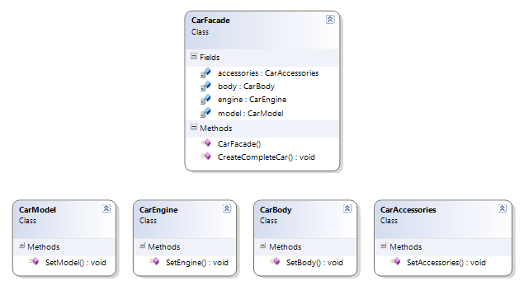
Facade Pattern Real Life Example
Notes:
Advantage of Decorator Pattern
It provides greater flexibility than static inheritance.
It enhances the extensibility of the object, because changes are made by coding new classes.
It simplifies the coding by allowing you to develop a series of functionality from targeted classes instead of coding all of the behavior into the object.

Slide 25
Facade Pattern Examples
User Registration Process
Process An Order
Creating User Follower Workflow

Slide 26
Outer operation
Inner operation 1
Inner operation 2
Inner operation 3
Orchestrator

Slide 27
DEMO
Facade Pattern Example
Notes:
Fasad

Slide 28
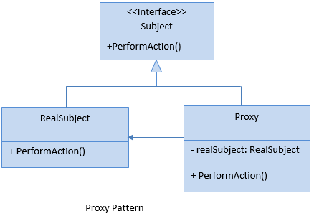
Proxy Pattern
Provide a surrogate object, which references to other object.
Proxy pattern involves a class, called proxy class, which represents functionality of another class.
Notes:
The concept is useful when you want to add some special functionality to a specific object instead of the whole class. This pattern prefers object composition over inheritance.

Slide 29
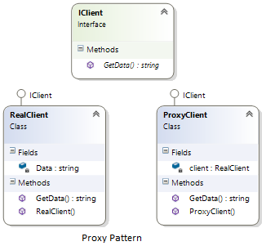
Proxy Pattern Real Life Example
Notes:
Advantage of Decorator Pattern
It provides greater flexibility than static inheritance.
It enhances the extensibility of the object, because changes are made by coding new classes.
It simplifies the coding by allowing you to develop a series of functionality from targeted classes instead of coding all of the behavior into the object.

Slide 30
Proxy Pattern Examples
Payment Processing
Accessing Backend Microservices
Accessing Remote Database

Slide 31
DEMO
Proxy Pattern Example

Slide 32
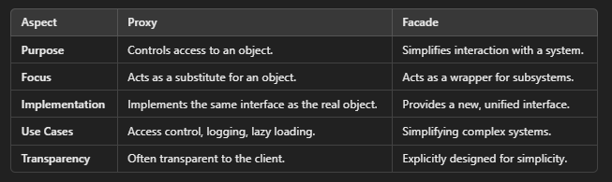
Facade vs Proxy

Slide 33
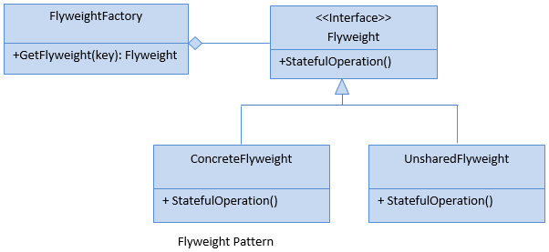
Flyweight Pattern
Used when there is a need to create a large number of objects of almost similar nature and they have some data in common.
A few shared objects can replace many unshared ones.
Notes:
The real life example is visiting cards in a company.

Slide 34
Flyweight Pattern Examples
Game Objects
Social Media Posts
List of Users
Notes:
The real life example is visiting cards in a company.

Slide 35
DEMO
Flyweight Pattern Example

